Slide 1

1.11.1.08 - Manage Vendor Registration - Liner Vendor
Vendor Creation and Registration
Copyright © Ocean Network Express Pte. Ltd. All Rights Reserved

Slide 2

Version Control
Ver | Date (dd Month yyyy) | BP Author (Office/Region) | Revision Notes
1.0 | 30 Jan 2024 | Rachel Lim | First draft

Slide 3
Vendor Creation and Registration
Objectives
To create and register ONE vendors in OPUS/Ariba/ERP systems for procurement and payment purposes
Chapters
OPUS Vendor Creation
Ariba Vendor Creation & Registration

Slide 4
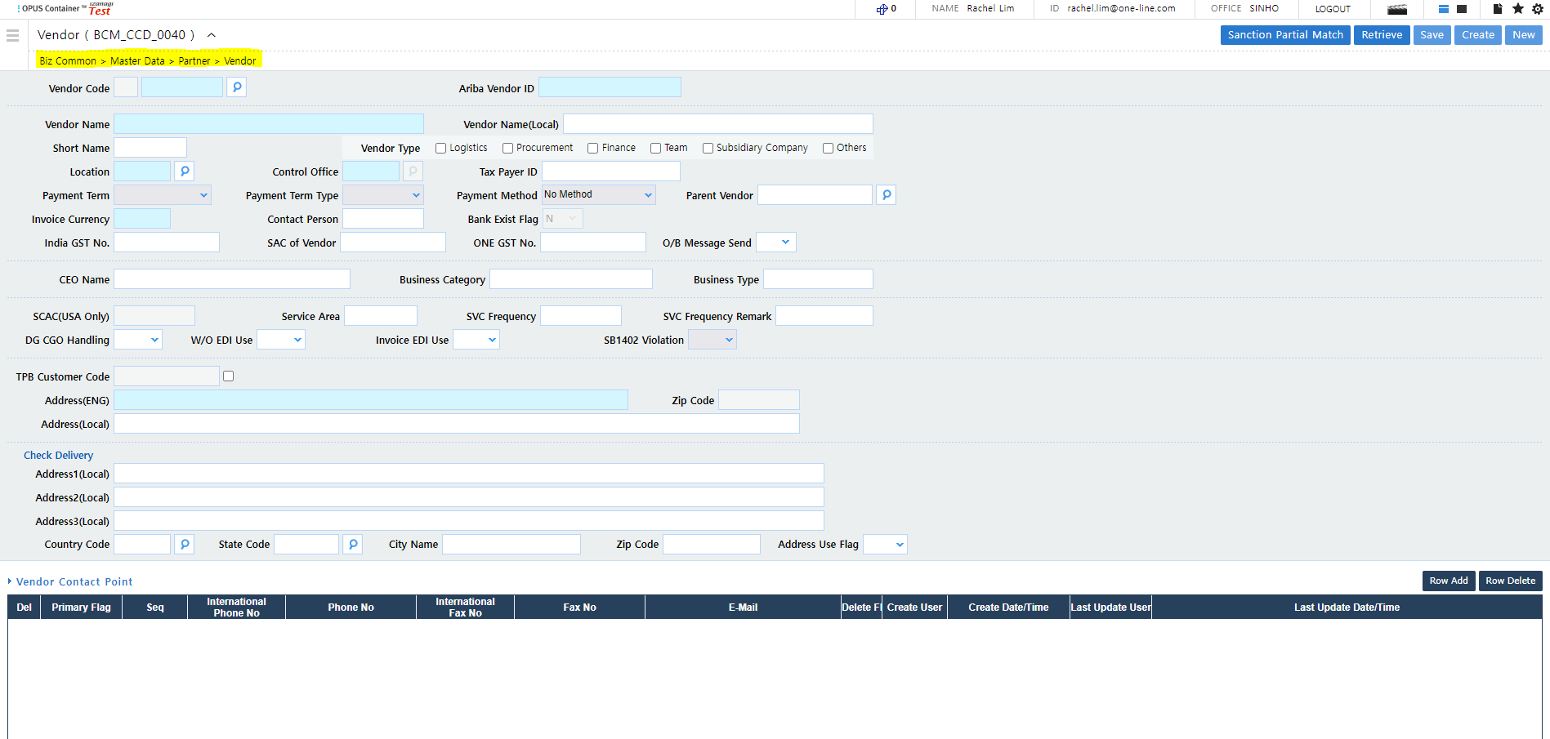
Vendor Creation and Registration
Path: Biz Common > Master Data > Partner > Vendor

Slide 5
OPUS Vendor Creation
OPUS vendor creation is only applicable for all non-procurement vendors.
Vendor Creation and Bank Details Registration
OPUS vendor creation is centrally handled by the Offshore Vendor Registration Team ( GHQ.VENDORADMIN.OFS@one-line.com ).
Request for creation of new OPUS vendor via the Vendor Creation/Update Form.
Submit the Vendor Application Form (VAF) via AODOCS for vendor bank details registration.
Vendor Details Update
Update of OPUS vendor details via Vendor Creation/Update Form.
Update of banking related fields via VAF submission through AODOCS.
Information
The vendor code needs to be created and VAF submitted in order for invoice to be created and payment to be processed.

Slide 6
Ariba Vendor Creation and Registration
Ariba vendor creation and registration is applicable for all procurement vendors (IOP, Feeder & Terminal (TES & TRS OPUS)).
Vendor Creation, Registration and Vendor Details Update
Refer to Vendor Registration & Update Process Post Ariba SLP Enhancement
Select applicable Line of Business (Feeder/Inland Ops/MNR/Terminal/Inland Ops NA Depot/Inland Ops NA Rail/Inland Ops NA Truck).
OPUS MDA Vendor Optional Fields Update
OPUS MDA Vendor optional fields are fields indicated with white boxes in the Vendor (BCM_CCD_0040) UI.
Update of OPUS MDA Vendor optional fields via Vendor Creation/Update Form.
Information
Vendor has to be in registered and qualified status to deem vendor registration as completed.
Supplier Registration completed and approved = Registered
F&A Banking Qualification (F&A Banking Questionnaire + F&A Internal Questionnaire) completed and approved = Qualified
For non-liner vendor, submit the Vendor Application Form (VAF) via AODOCS for vendor registration.
Notes:
For non-liner vendor, the same vendor creation and registration process in Ariba applies. Select Line of Business = Corporate.
Process map: (Global) 1.11.1.08 - Manage Vendor Registration - GHQ Non-Liner Vendor

Slide 7
End of Presentation…
grazie
tänan
תודה
شكر
Gracias
köszönet
dank
благодаря
shukrani
díky
Thank You
завдяки
kiitos
Danke
tak
teşekkürler
paldies
Merci
mulțumiri
takk
dėkui
Dzięki
ευχαριστώ

